Slide 1


Slide 2
CSS 2017
Every Day Science Part 2
General Ability
Marks 40
Marks distribution
MCQ 10
Subjective Total Question 5
3 Question have to solve each carry 10 marks

Slide 3
Syllabus for General Ability
Quantitative Ability/Reasoning
Basic Mathematics skills
Concept and ability to reasons quantitatively and solve problems in a quantitative settings
Basic Arithmetic, Algebra and Geometry(Average, Ratios, Rates, Percentage, angles, triangles, sets, Remainders, Equations, Symbols, rounding of numbers )
Random Sampling

Slide 4
Logical Reasoning and Analytical Reasoning/ability
Logical reasoning
Analytical Reasoning/Ability

Slide 5
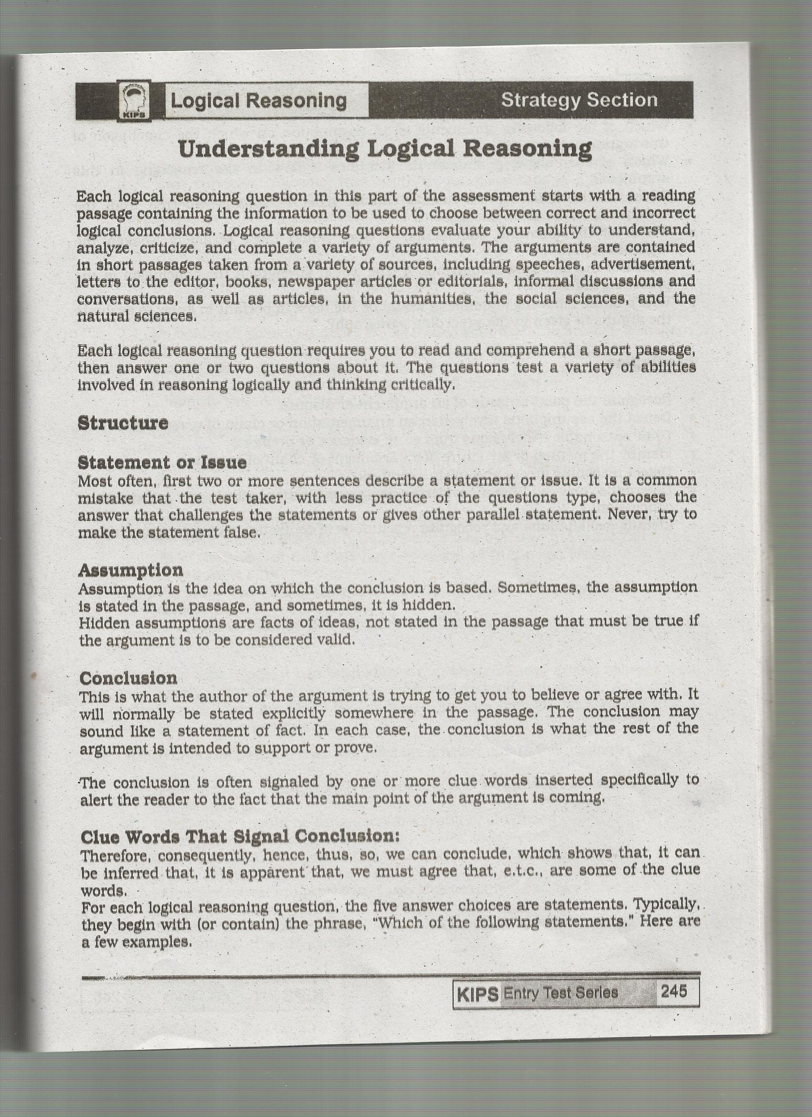

Slide 6
Anological reasonoing

Slide 7
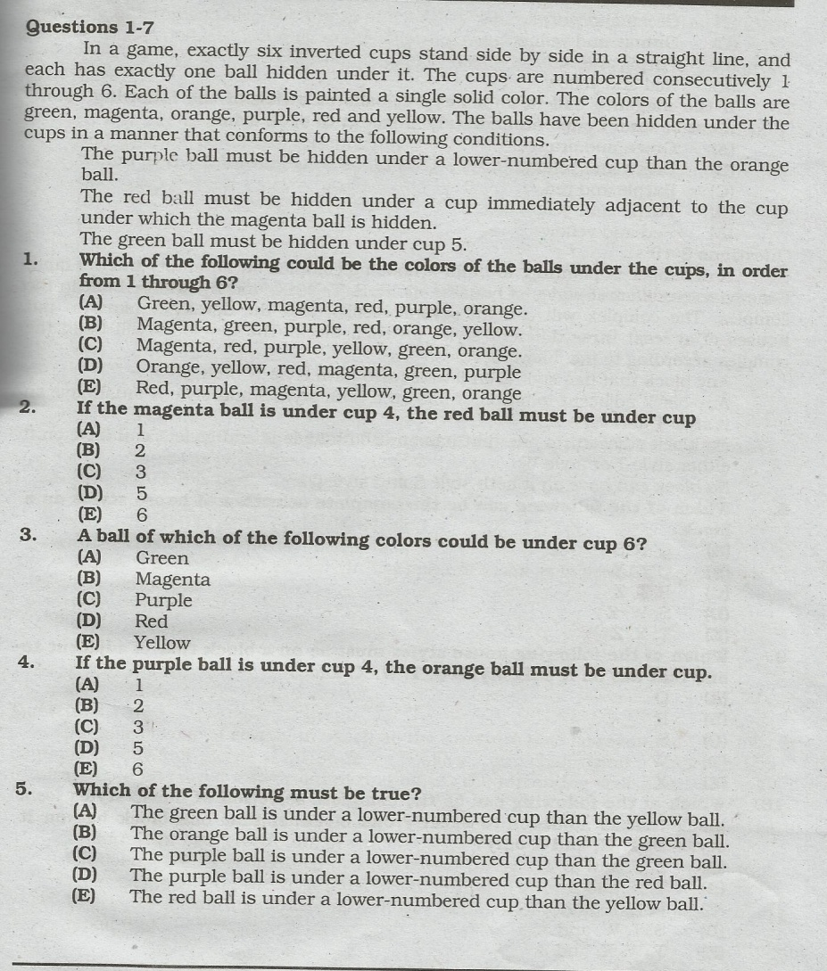
Analytical ability

Slide 8
continued

Slide 9
Mental Abilities
Verbal Ability
Mechanical ability
Numerical ability
Social Ability

Slide 10
Syllabus break up
Lecture 01
Quantitative Ability/Reasoning
Basic Mathematics skills
Concept and ability to reasons quantitatively and solve problems in a quantitative settings
Basic Arithmetic
Sets
Average(Mean, Median and mode)
Percentage
Rates
Ratios
Practice session

Slide 11
Lecture 02
Proportions
LCM and HCF
Algebra and Geometry
Equations
rounding of numbers
Angles
Triangles
Symbols
Random Sampling
Practice session
Assignment

Slide 12
Lecture 03
Mental Abilities
Verbal Ability
Mechanical ability
Numerical ability
Social Ability
Practice session

Slide 13
Lecture 04
Logical reasoning
Analytical Reasoning/Ability
Practice session
Assignment

Slide 14
Lecture 05
Information Technology
Computer
I/O Processing
Data Storage
Networking and internet standards
Application and Business software
Social Media Websites/ Information systems
Fundamentals of Artificial Intelligence

Slide 15
continued
Telecommunication
Basic of wireless Telecommunication
Mobiles
Satellites
Surveillance and GPS
SONAR, RADAR
Fiber Optics
Test of first four lectures/Assignment

Slide 16
Practice question
Which of the following sets represents the integers
Set of number from 2 to onward
Set of all prime numbers
Set of negative numbers from 0 to onward
Set of all positive and negative numbers start from 1
None of the above

Slide 17
Average
If seven students of the class got 35,37,39,41,46,43,42 marks in math test, then eight student has to secure how many scores ? So that average will be come 40
Average working hour of the factory worker
Are 8 hour, total workers in the factory are 10. The benevolent manger has given relaxation to the 2 sick workers to work only for 4 hours, then remaining 6 workers, each, have to work how many hour additionally to keep the production level same ?

Slide 18
Mean, median and mode
Find the median of the given data
5,3,7,2,9,7
Find the median of the given data and range?
13,15,17,19,21,23
Find the mode
17, 18,19,20,17,18,21

Slide 19
Percentage
Convert 6 ½ % into fraction
Convert the 0.007 into percentage
if an article cost 480$ to the shopkeeper, to gain 20% profit at what price shopkeeper has to sale that article
A butcher wants to maximize his profit in one kg of meet from 10% t0 25%. How will he has to adjust price from 250 to earn the desired profit?

Slide 20
Percentage
What was Yusuf's income last year if he paid Rs
18,350 an income tax which is 40% of his income
After a discount of 25% the sale price of a suitcase is Rs 846. what was the original price of the suitcase

Slide 21
Rates
If a businessman had an assets of 1,20000, after some time his asset increased to 5,80,000. what was the rate of change?
If 500$ invested at the rate of 5% annum per year. How will it take to reach at 850$?
Find a simple interest on a 90 days loan of 90,000 at 15%.
Find the amount of money gained from an investment of Rs.800 for three years at 10% annum compound interest.

Slide 22
ratio
Simple Ratio
An employ gets one fourth of his pay as house rent allowance. If he gets Rs 6000 as house rent allowance. What is his pay?
Distribute inheritance of 1,00,000 among two brothers Akram and Aslam,two sisters Najma and Salma so that Aslam gets twice of akram and Najma will get half of Salma.

Slide 23
Continued Ratio
Nawaz , Shabaz and Faraz have to divide a piece of land among themselve. The area of this piece of land is 804 sq meter if the ratio between the shares of Nawaz and Shabaz is 7:4 and the between the shares of Shabaz and Faraz is 5:3 find the share of each?

Slide 24
Thank You

